Slide 1
Chapter 16 : Concurrency Control

Slide 2
Chapter 16: Concurrency Control
Lock-Based Protocols（基于锁的协议）
Timestamp-Based Protocols（基于时间戳的协议）
Validation-Based Protocols（基于验证的协议）
Multiple Granularity（多粒度）
Multiversion Schemes（多版本模式）
Insert and Delete Operations（插入和删除操作）

Slide 3
Lock-Based Protocols
A lock is a mechanism to control concurrent access to a data item
Data items can be locked in two modes :
1. exclusive (X) mode，X-lock， lock-X instruction
2. shared (S) mode，S-lock ,lock-S instruction.
Lock requests are made to concurrency-control manager. Transaction can proceed only after request is granted.

Slide 4

Lock-Based Protocols (Cont.)
Lock-compatibility matrix
A transaction may be granted or to wait till be granted

Slide 5
Lock-Based Protocols (Cont.)
Example of a transaction performing locking:
T₂: lock-S(A);
read (A);
unlock(A);
lock-S(B);
read (B);
unlock(B);
display(A+B)

Slide 6

Partial Schedule Under Two-Phase Locking
Notes:
图16-4

Slide 7
Lock-Based Protocols (Cont.)
Locking as above is not sufficient to guarantee serializability
A locking protocol is a set of rules followed by all transactions while requesting and releasing locks.
Notes:
？

Slide 8

Pitfalls of Lock-Based Protocols
Consider the partial schedule
Deadlock死锁 a necessary evil
Starvation饿死 is also possible if concurrency control manager is badly designed.

Slide 9
The Two-Phase Locking Protocol
This is a protocol which ensures conflict-serializable schedules.
Phase 1: Growing Phase 扩展阶段
  transaction may obtain locks
  transaction may not release locks
Phase 2: Shrinking Phase 收缩阶段
  transaction may release locks
  transaction may not obtain locks

Slide 10
2PL example
T₂ T₁
lock-X(A);
read (A);
A=A-50
write(A)
Lock-S(a); lock-X(B);
read (a); read(B);
B=B+50;
write(B);
unlock(A);
        unlock(B); Commit;
T₂ T₁
lock-S(b);
read (b);
Unlock(A);
Unlock(B);
display(A+B)
Commit

Slide 11
The Two-Phase Locking Protocol
assures serializability. It can be proved that the transactions can be serialized in the order of their lock points (i.e. the point where a transaction acquired its final lock).
does not ensure freedom from deadlocks
Cascading roll-back is possible under two-phase locking.
Notes:
？

Slide 12
The Two-Phase Locking Protocol (Cont.)
Strict严格 two-phase locking. Here a transaction must hold all its exclusive locks till it commits/aborts.
Rigorous强 two-phase locking is even stricter: here all locks are held till commit/abort.

Slide 13
Lock Conversions锁转换
Two-phase locking with lock conversions:
– First Phase:
  can acquire a lock-S on item
  can acquire a lock-X on item
  can convert a lock-S to a lock-X (upgrade)
– Second Phase:
  can release a lock-S
  can release a lock-X
  can convert a lock-X to a lock-S (downgrade)
This protocol assures serializability.
Notes:
But still relies on the programmer to insert the various locking instructions.

Slide 14

Incomplete Schedule With a Lock Conversion

Slide 15
Graph-Based Protocols
an alternative to two-phase locking
Impose a partial ordering → on the set D = {d₁, d₂ ,..., d_{h}} of all data items.
  If d_{i} → d_{j} then any transaction accessing both d_{i} and d_{j} must access d_{i} before accessing d_{j}.
  Implies that the set D may now be viewed as a directed acyclic graph有向无环图, called a database graph数据库图.
Notes:
预先规定一个封锁顺序，所有的事务都要按这个顺序实行封锁。

Slide 16
Tree Protocol树形协议
The tree-protocol is a simple kind of graph protocol.
  Only exclusive locks are allowed.
  The first lock by T_{i} may be on any data item. Subsequently, a data Q can be locked by T_{i} only if the parent of Q is currently locked by T_{i}.
  Data items may be unlocked at any time.
  A data item that has been locked and unlocked by T_{i} cannot subsequently be relocked by T_{i}

Slide 17

Tree Protocol

Slide 18
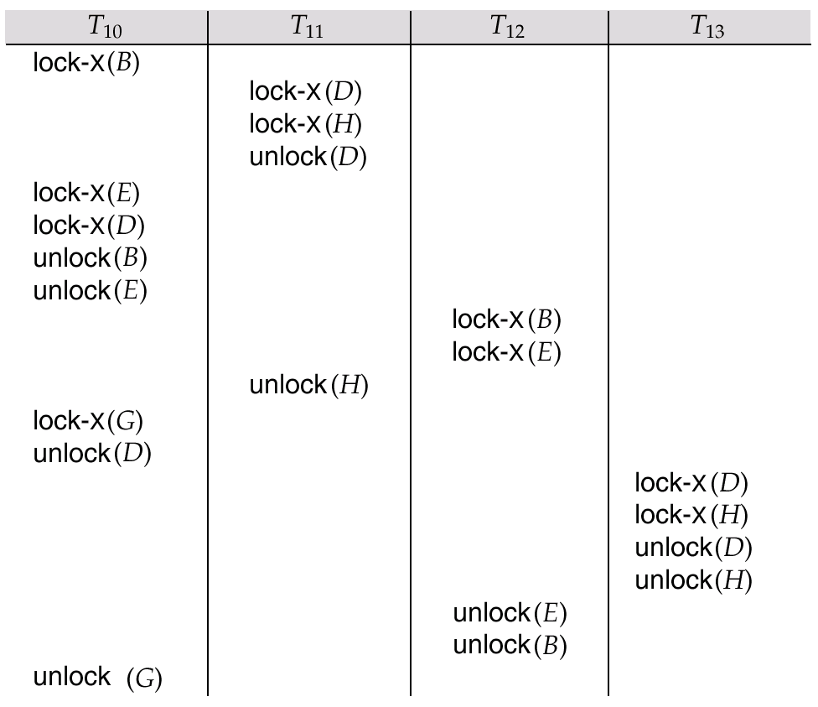
Serializable Schedule Under the Tree Protocol

Slide 19
Graph-Based Protocols (Cont.)
Privilege
  ensures conflict serializability
  freedom from deadlock.
  Unlocking may occur earlier than in the two-phase locking protocol.
Drawbacks
  does not guarantee recoverability (commit dependencies)
  may have to lock data items that they do not access.
Schedules not possible under two-phase locking are possible under tree protocol, and vice versa.

Slide 20
Multiple Granularity（多粒度）
Allow data items to be of various sizes and define a hierarchy of data granularities, where the small granularities are nested within larger ones
Can be represented graphically as a tree (but don't confuse with tree-locking protocol)

Slide 21

Example of Granularity Hierarchy
The levels, starting from the coarsest (top) level are
  database
  area
  file
  record

Slide 22
Multiple Granularity
Granularity of locking :
  fine granularity (lower in tree): high concurrency, high locking overhead
  coarse granularity (higher in tree): low locking overhead, low concurrency

Slide 23
In addition to S and X lock modes, there are three additional lock modes with multiple granularity:
  intention-shared (IS)意向共享锁
  intention-exclusive (IX)意向排他锁
  shared and intention-exclusive (SIX)共享意向排他锁
  意向锁目的：
  提高对某个数据对象加锁时系统的检查效率

Slide 24
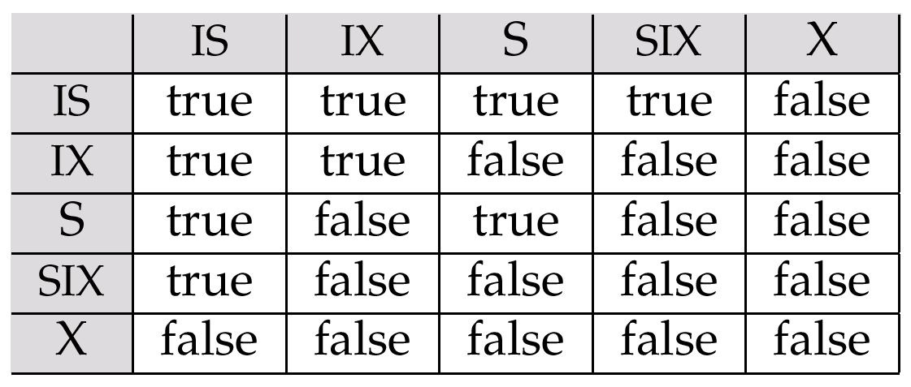
Intention Lock Modes（意向锁模式）
The compatibility matrix for all lock modes is:

Slide 25
Multiple Granularity Locking(多粒度锁) Scheme
Transaction T_{i} can lock a node Q, using the following rules:
  The lock compatibility matrix must be observed.
  The root of the tree must be locked first, and may be locked in any mode.
  A node Q can be locked by T_{i} in S or IS mode only if the parent of Q is currently locked by T_{i} in either IX or IS mode.

Slide 26
Multiple Granularity Locking(多粒度锁) Scheme
  A node Q can be locked by T_{i} in X, SIX, or IX mode only if the parent of Q is currently locked by T_{i} in either IX or SIX mode.
  T_{i} can lock a node only if it has not previously unlocked any node (that is, T_{i} is two-phase).
  T_{i} can unlock a node Q only if none of the children of Q are currently locked by T_{i}.

Slide 27
Deadlock Handling（死锁处理）
Consider the following two transactions:
T₁: write (X) T₂: write(Y)
write(Y) write(X)
Schedule with deadlock
T₁
T₂
lock-X on X
write (X)
lock-X on Y
write (Y)
wait for lock-X on X
wait for lock-X on Y

Slide 28
Deadlock Handling
死锁：System is deadlocked if there is a set of transactions such that every transaction in the set is waiting for another transaction in the set.
死锁预防（Deadlock prevention）:
  Require that each transaction locks all its data items before it begins execution (predeclaration).
  Impose partial ordering of all data items and require that a transaction can lock data items only in the order specified by the partial order (graph-based protocol).
Notes:
预先规定一个封锁顺序，所有的事务都要按这个顺序实行封锁。

Slide 29
More Deadlock Prevention Strategies
Following schemes use transaction timestamps for the sake of deadlock prevention alone.
wait-die scheme(等待-死亡策略) — non-preemptive（非抢占的）
  older transaction may wait for younger one to release data item. Younger transactions never wait for older ones; they are rolled back instead.
  a transaction may die several times before acquiring needed data item

Slide 30
More Deadlock Prevention Strategies
Following schemes use transaction timestamps for the sake of deadlock prevention alone.
wound-wait scheme（击伤-等待策略） — preemptive（抢占的）
  older transaction wounds (forces rollback) of younger transaction instead of waiting for it. Younger transactions may wait for older ones.
  may be fewer rollbacks than wait-die scheme.

Slide 31
Deadlock prevention (Cont.)
Timeout-Based Schemes :
  a transaction waits for a lock only for a specified amount of time. After that, the wait times out and the transaction is rolled back.
  thus deadlocks are not possible
  simple to implement; but starvation is possible. Also difficult to determine good value of the timeout interval.

Slide 32
Deadlock Detection（死锁检测）
Deadlocks can be described as a wait-for graph等待图, which consists of a pair G = (V,E),
  V is a set of vertices (all the transactions in the system)
  E is a set of edges; each element is an ordered pair T_{i} →T_{j}.

Slide 33


Deadlock Detection (Cont.)
Wait-for graph without a cycle
Wait-for graph with a cycle

Slide 34
Deadlock Recovery
When deadlock is detected :
  Some transaction will have to rolled back
  Rollback -- determine how far to roll back transaction
    Total rollback
    only as far as necessary
  Include the number of rollbacks in the cost factor to avoid starvation

Slide 35
Other Approaches to Concurrency Control

Slide 36
Timestamp-Based Protocols
Each transaction is issued a timestamp when it enters the system.
the protocol maintains for each data Q two timestamp values:
  W-timestamp(Q) is the largest time-stamp of any transaction that executed write(Q) successfully.
  R-timestamp(Q) is the largest time-stamp of any transaction that executed read(Q) successfully.

Slide 37
Timestamp-Based Protocols
The protocol manages concurrent execution such that the time-stamps determine the serializability order.
The timestamp ordering protocol ensures that any conflicting read and write operations are executed in timestamp order.

Slide 38
Timestamp-Based Protocols (Cont.)
Suppose a transaction T_{i} issues a read(Q)
  If TS(T_{i}) ≤ W-timestamp(Q), then T_{i} needs to read a value of Q that was already overwritten.
    Hence, the read operation is rejected, and T_{i} is rolled back.
  If TS(T_{i})≥ W-timestamp(Q), then the read operation is executed, and R-timestamp(Q) is set to max(R-timestamp(Q), TS(T_{i})).

Slide 39
Timestamp-Based Protocols (Cont.)
Suppose that transaction T_{i} issues write(Q).
  If TS(T_{i}) < R-timestamp(Q), then the value of Q that T_{i} is producing was needed previously, and the system assumed that that value would never be produced.
    Hence, the write operation is rejected, and T_{i} is rolled back.
  If TS(T_{i}) < W-timestamp(Q), then T_{i} is attempting to write an obsolete value of Q.
    Hence, this write operation is rejected, and T_{i} is rolled back.
  Otherwise, the write operation is executed, and W-timestamp(Q) is set to TS(T_{i}).

Slide 40
Example Use of the Protocol
A partial schedule for several data items for transactions with
timestamps 1, 2, 3, 4, 5
T₁
T₂
T₃
T₄
T₅
read(X)
read(Y)
read(Y)
write(Y)
write(Z)
read(Z)
read(X)
abort
read(X)
write(Z)
abort
write(Y)
write(Z)

Slide 41
Correctness of Timestamp-Ordering Protocol
The timestamp-ordering protocol guarantees serializability since all the arcs in the precedence graph are of the form:
Timestamp protocol ensures freedom from deadlock as no transaction ever waits.
transaction
with smaller
timestamp
transaction
with larger
timestamp

Slide 42
Recoverability and Cascade Freedom
Problem with timestamp-ordering protocol
  schedule may not be cascade-free, and may not even be recoverable.
  cascading rollback

Slide 43
Thomas’ Write Rule
Modified version of the timestamp-ordering protocol in which obsolete write operations may be ignored under certain circumstances.
Thomas' Write Rule allows greater potential concurrency.
  Allows some view-serializable schedules that are not conflict-serializable.

Slide 44
Validation-Based Protocol
（基于验证的协议）
Execution of transaction T_{i} is done in three phases.
1. Read and execution phase
2. Validation phase
3. Write phase
Each transaction T_{i} has 3 timestamps
  Start(T_{i}) : the time when T_{i} started its execution
  Validation(T_{i}): the time when T_{i} entered its validation phase
  Finish(T_{i}) : the time when T_{i} finished its write phase

Slide 45
Validation-Based Protocol (Cont.)
The three phases of concurrently executing transactions can be interleaved
each transaction must go through the three phases in that order.
Serializability order is determined by timestamp given at validation time, to increase concurrency.
optimistic concurrency control
is useful and gives greater degree of concurrency if probability of conflicts is low.

Slide 46
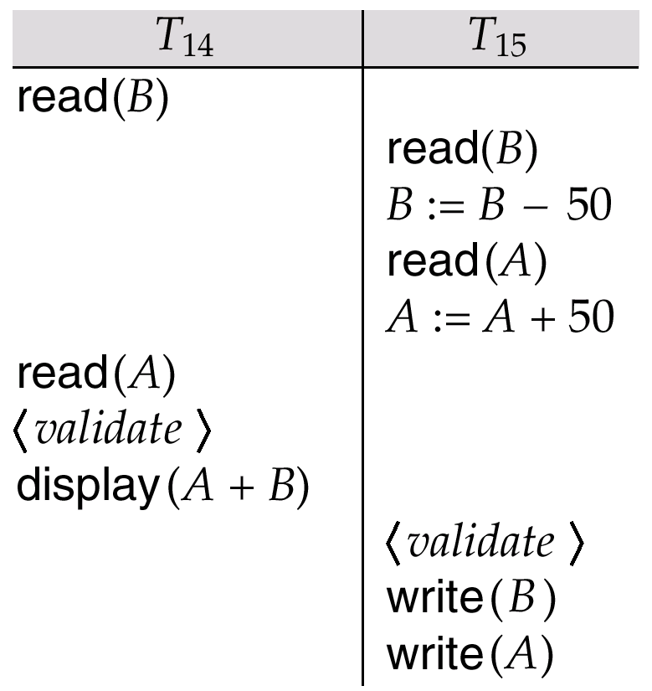
Schedule 5, A Schedule Produced by Using Validation

Slide 47
Multiversion Schemes（多版本模式）
Multiversion schemes keep old versions of data item to increase concurrency.
  Multiversion Timestamp Ordering
  Multiversion Two-Phase Locking
Each successful write results in the creation of a new version of the data item written.
Use timestamps to label versions.

Slide 48
Multiversion Timestamp Ordering
Each data item Q has a sequence of versions <Q₁, Q₂,...., Q_{m}>. Each version Q_{k} contains three data fields:
  Content -- the value of version Q_{k}.
  W-timestamp(Q_{k}) -- timestamp of the transaction that created (wrote) version Q_{k}
  R-timestamp(Q_{k}) -- largest timestamp of a transaction that successfully read version Q_{k}
when a transaction T_{i} creates a new version Q_{k} of Q, Q_{k}'s W-timestamp and R-timestamp are initialized to TS(T_{i}).
R-timestamp of Q_{k} is updated whenever a transaction T_{j} reads Q_{k}, and TS(T_{j}) > R-timestamp(Q_{k}).

Slide 49
Multiversion Timestamp Ordering (Cont)
Suppose that transaction T_{i} issues a read(Q) or write(Q) operation. Let Q_{k} denote the version of Q whose write timestamp is the largest write timestamp less than or equal to TS(T_{i}).
  If transaction T_{i} issues a read(Q), then the value returned is the content of version Q_{k}.
  If transaction T_{i} issues a write(Q)
    if TS(T_{i}) < R-timestamp(Q_{k}transaction T_{i} is rolled back.
    if TS(T_{i}) = W-timestamp(Q_{k}), the contents of Q_{k} are overwritten
    else a new version of Q is created.

Slide 50
Observe that
    Reads always succeed
    A write by T_{i} is rejected if some other transaction T_{j} that (in the serialization order defined by the timestamp values) should read
    T_{i}'s write, has already read a version created by a transaction older than T_{i}.
Protocol guarantees serializability

Slide 51
Insert and Delete Operations
If two-phase locking is used :
  A delete operation may be performed only if the transaction deleting the tuple has an exclusive lock on the tuple to be deleted.
  A transaction that inserts a new tuple into the database is given an X-mode lock on the tuple
Insertions and deletions can lead to the phantom phenomenon（幻像）.

Slide 52
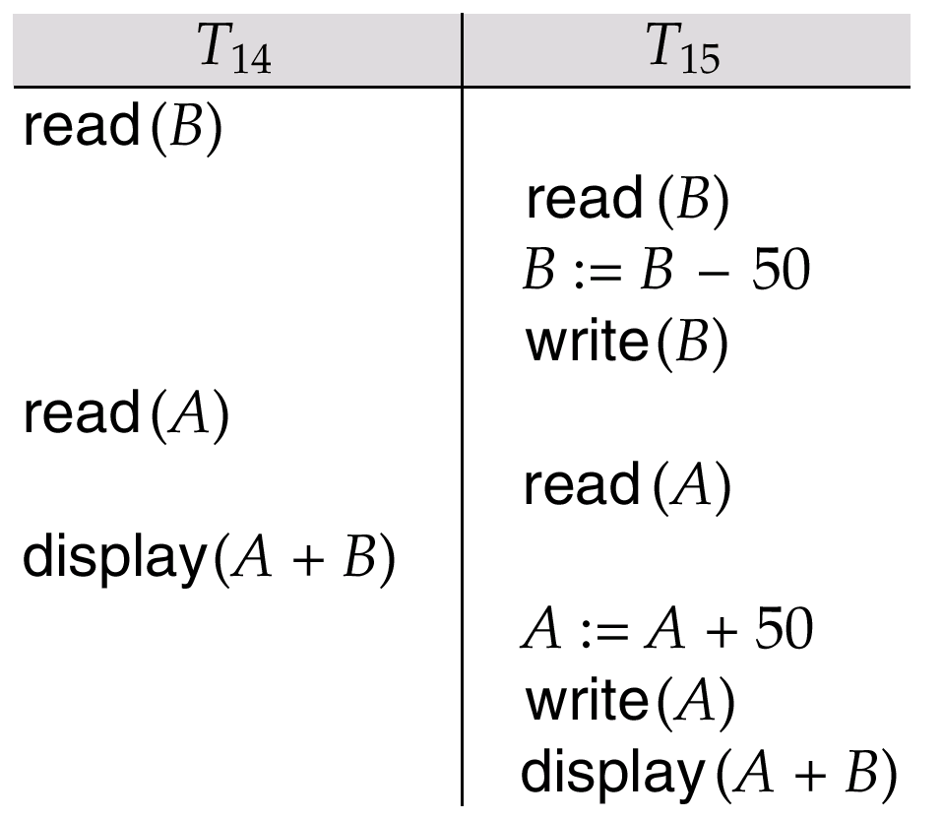
Schedule 3

Slide 53
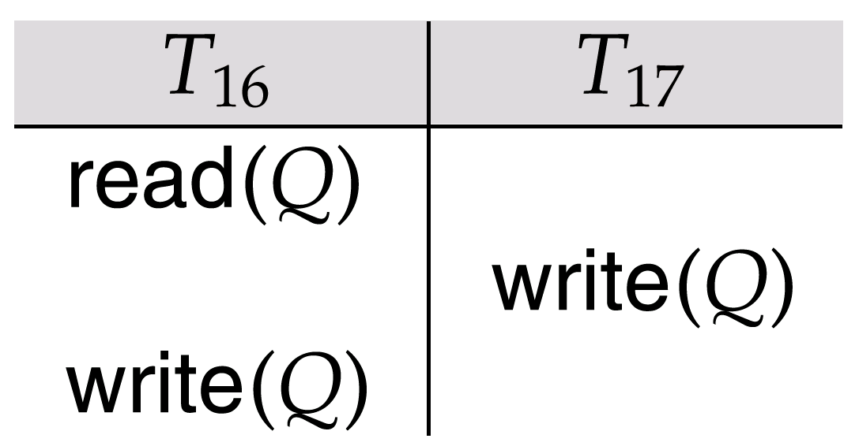
Schedule 4

Slide 54
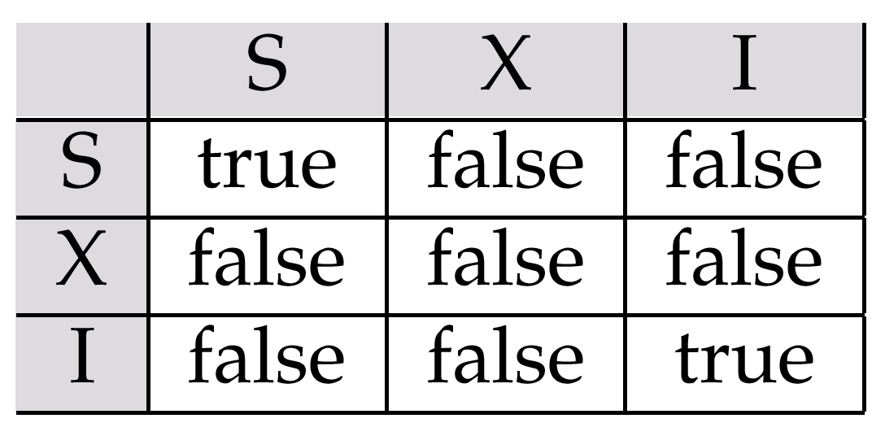
Lock-Compatibility Matrix

